Slide 1
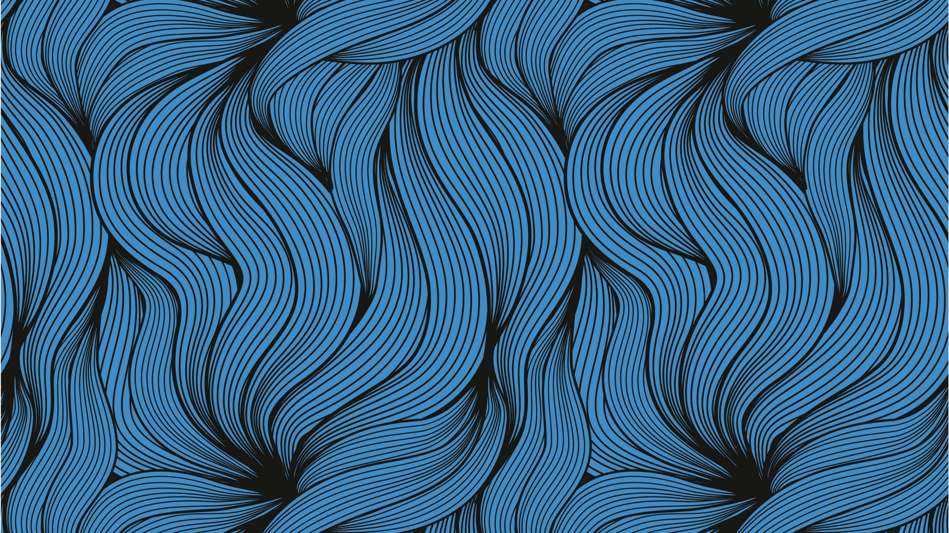
Liver segmentation of ct images with deep learning
Soubith Babu Kanatan – 20BAI1177
Girisankar G – 20BAI1259

Slide 2
CONTENT
Abstract
Introduction
Dataset Used
Block Diagram
Architecture
Implementation
Conclusion

Slide 3
ABSTRACT
Liver cancer is one of the leading causes of cancer-related deaths worldwide. Early detection and treatment are crucial for improving patient outcomes. Accurate segmentation of liver tumors in medical images, such as CT scans and MRI images, is essential for this process. UNet, a convolutional neural network (CNN) architecture, has emerged as a powerful tool for image segmentation, demonstrating remarkable performance in various medical imaging applications. This project delves into the application of UNet for liver tumor segmentation, exploring its architecture, training process.
UNet comprises a contracting path and an expansive path, each composed of convolutional and pooling or upsampling layers, respectively. Skip connections bridge these paths, enabling the network to capture contextual information from both high-resolution and low-resolution feature maps. This combination of skip connections and multi-resolution feature extraction enables UNet to excel in precise localization of features, particularly beneficial for segmenting intricate structures like liver tumors.

Slide 4
INTRODUCTION
Hepatocellular carcinoma (HCC), another name for liver cancer, is a kind of cancer that starts in the liver, which is the biggest solid organ in the human body. The liver is essential for several body processes, such as bile generation, protein synthesis, and detoxification. Any area of the liver can develop liver cancer, which can range in kind from benign (non-cancerous) to malignant (cancerous). Diagnosing liver cancer typically involves a combination of imaging tests, blood tests, and liver biopsies.
Liver tumor segmentation is the process of identifying the boundaries of a liver tumor in a CT image. CT images can be used to detect liver tumors and to track their growth over time. Deep learning has been shown to be very effective for liver tumor segmentation, and it is now the most widely used method for this task.
We apply UNet architecture for the efficient segmentation of liver cancers from CT images. Convolutional neural networks (CNNs) like UNet were created especially for biomedical image segmentation applications. Its U-shaped design, which consists of an expanding path and a contracting path, allows it to extract both low-level and high-level characteristics from the input picture. This makes it possible to precisely segment complex objects, such as liver tumors, even when noise and artifacts are present.

Slide 5
DATASET USED
The 3D-IRCADb-01 database is composed of the 3D CT-scans of 10 women and 10 men with hepatic tumours in 75% of cases. The 20 folders correspond to 20 different patients, which can be downloaded individually or conjointly.
The CT scans are accompanied by manual segmentations of the liver and tumors, which serve as ground truth for evaluating segmentation algorithms.
The dataset is realistic as it includes scans of real patients with hepatic tumors, reflecting the challenges encountered in clinical practice.
It has a diverse patient population. It represents a diverse range of patients in terms of age, gender, and tumor characteristics.
https://www.ircad.fr/research/data-sets/liver-segmentation-3d-ircadb-01/

Slide 6
Architecture
We make use of the Unet architecture in this project. UNet is a popular architecture for image segmentation tasks because it is able to achieve high accuracy while being computationally efficient.
It is a fully convolutional network, meaning that it only uses convolutional layers and does not have any fully connected layers. This makes UNet well-suited for image segmentation tasks because it can preserve spatial information throughout the network.
UNet consists of two main paths: a contracting path and an expansive path. The contracting path consists of a series of convolutional and pooling layers that reduce the spatial resolution of the input image. The expansive path consists of a series of transposed convolutional and upsampling layers that increase the spatial resolution of the feature maps.
At each level of the network, the contracting and expansive paths are connected by skip connections. These skip connections allow the network to learn precise localization of features at different scales.

Slide 7
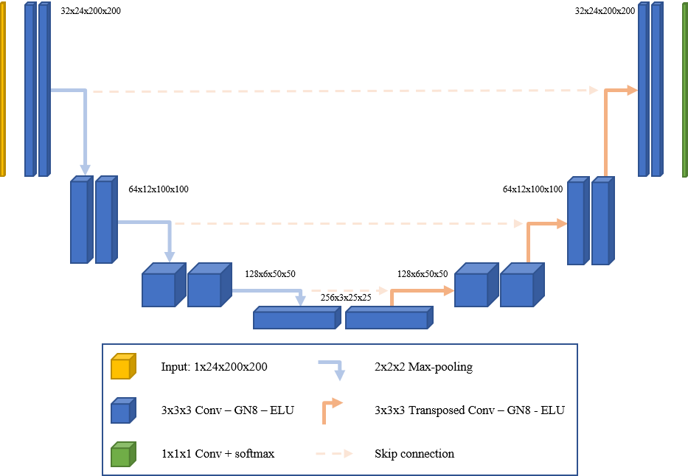
Architecture

Slide 8
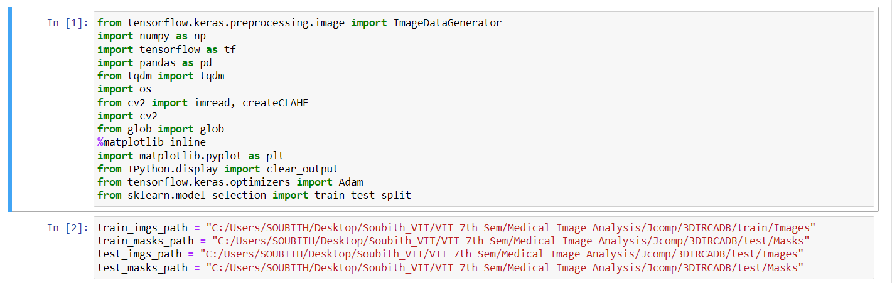
Implementation

Slide 9
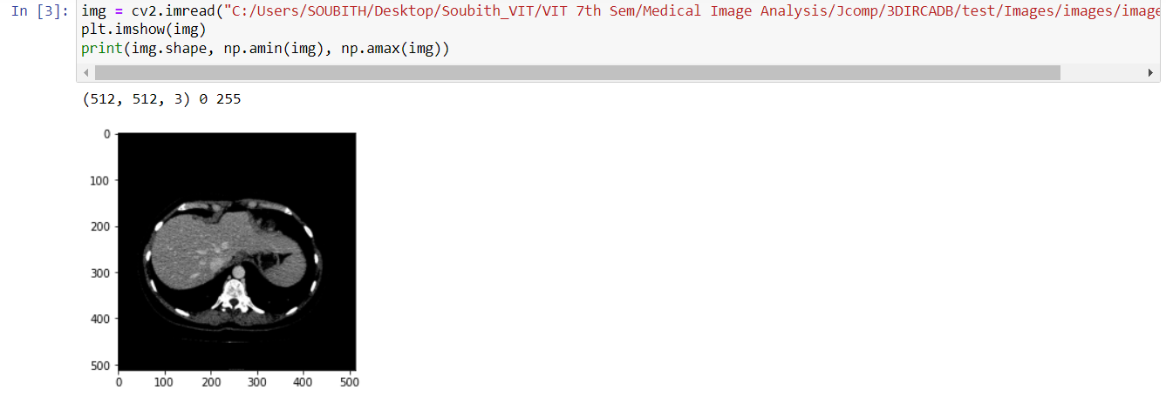
Implementation

Slide 10
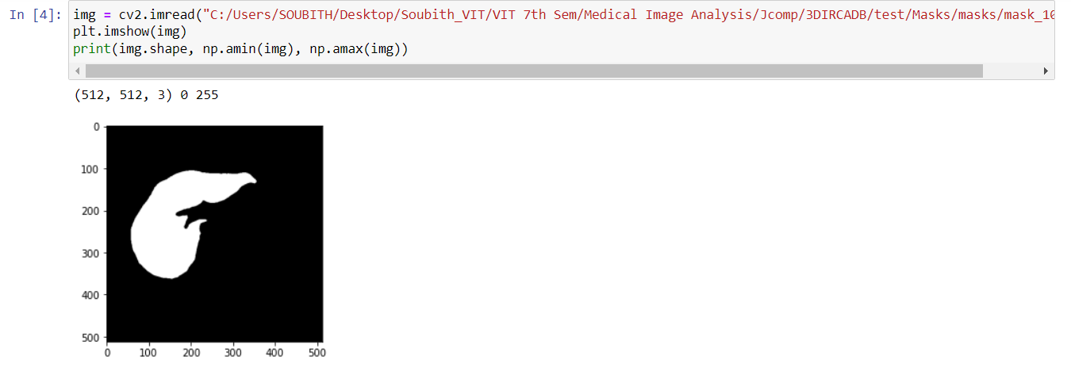
Implementation

Slide 11
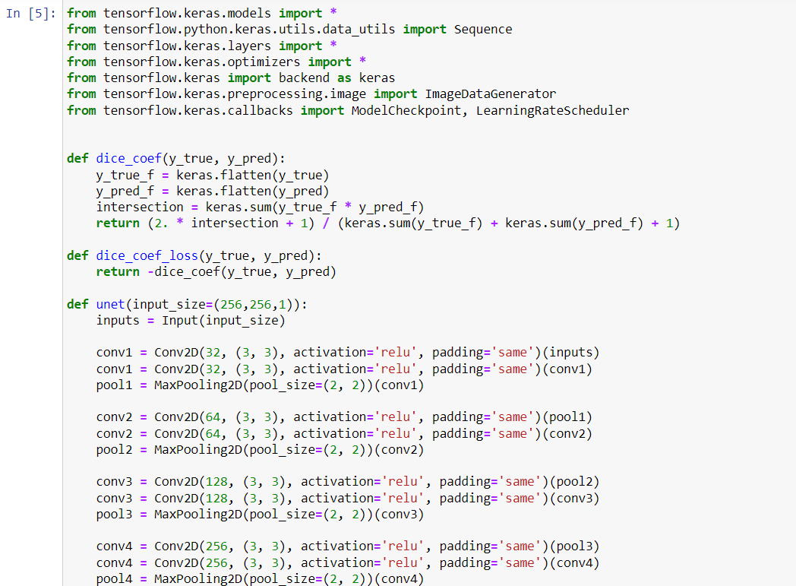
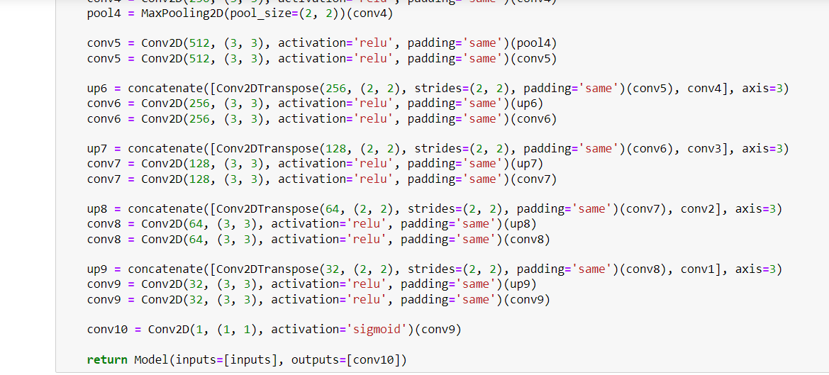
Implementation

Slide 12
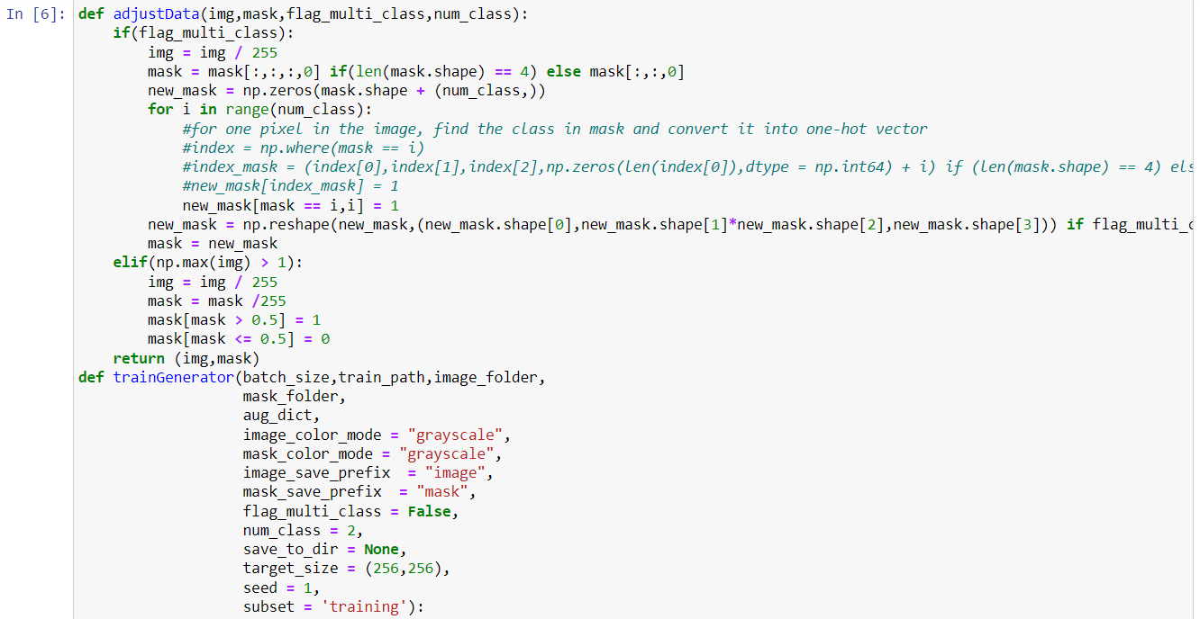
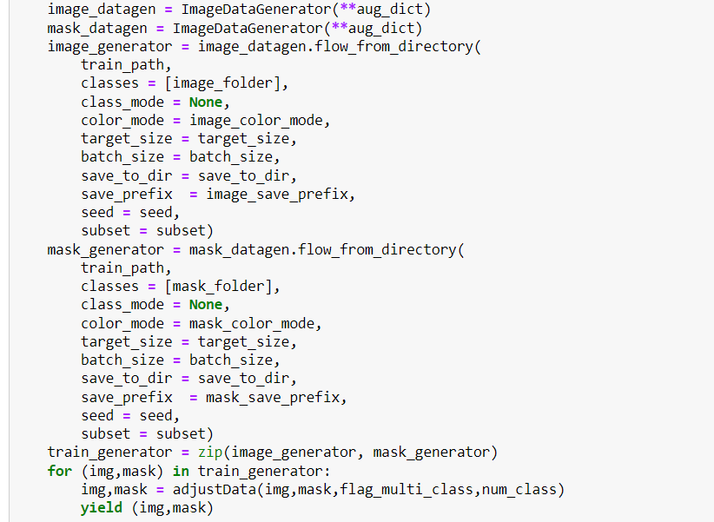
Implementation

Slide 13
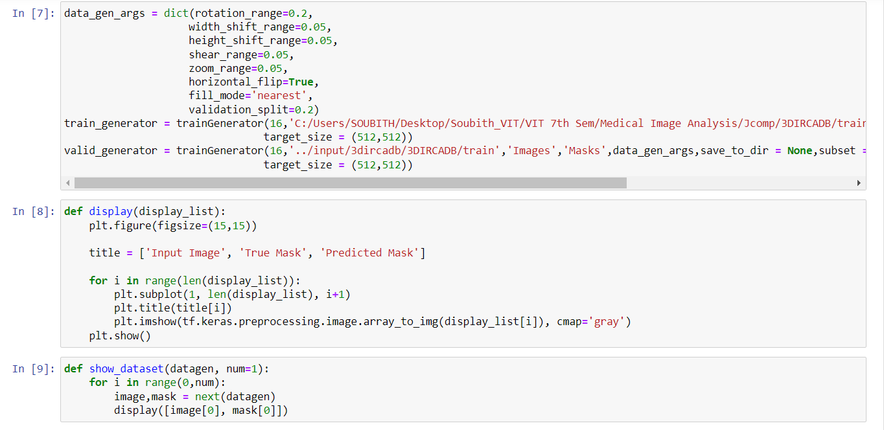
Implementation

Slide 14
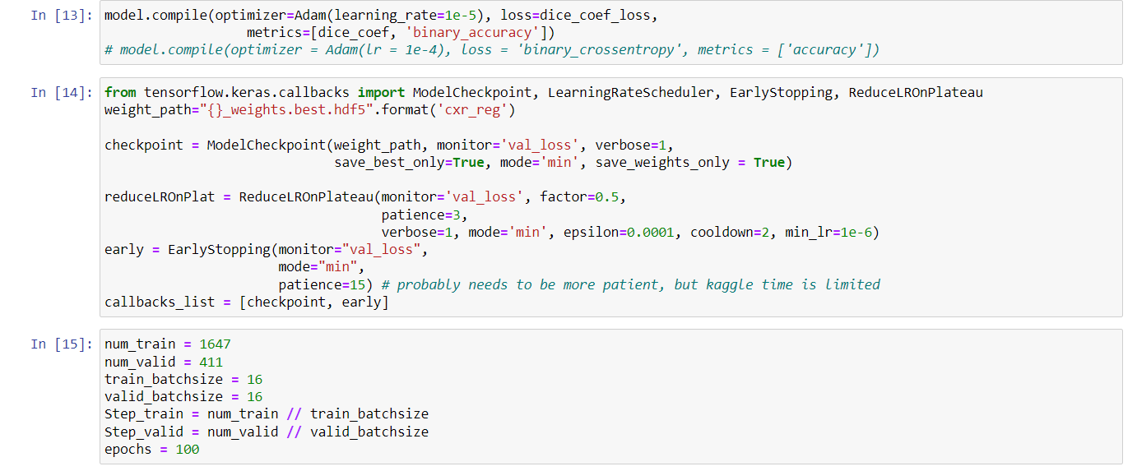
Implementation

Slide 15
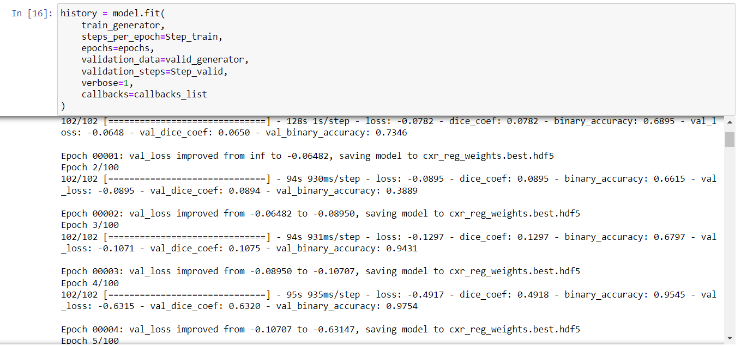
Implementation

Slide 16
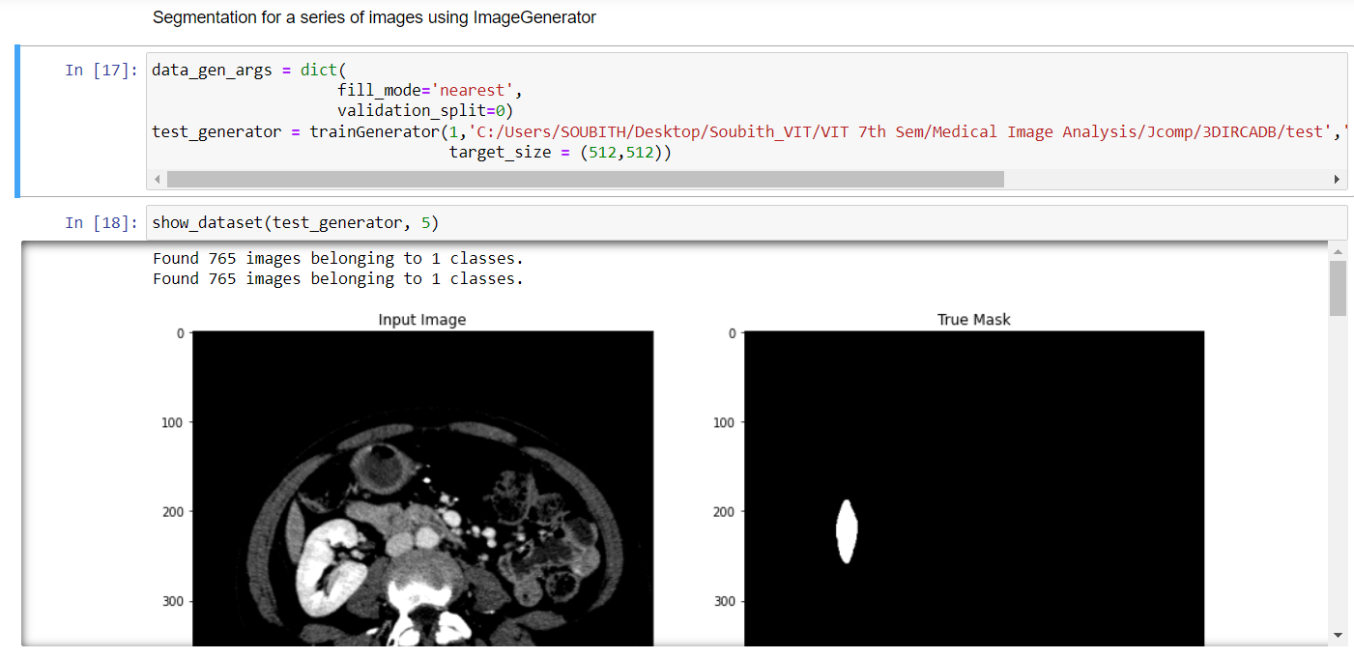
Implementation

Slide 17
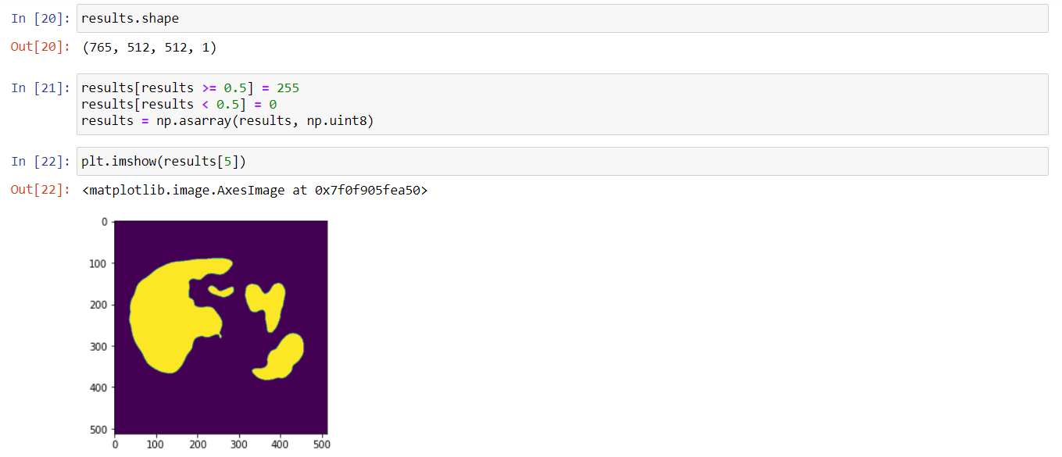
Implementation

Slide 18
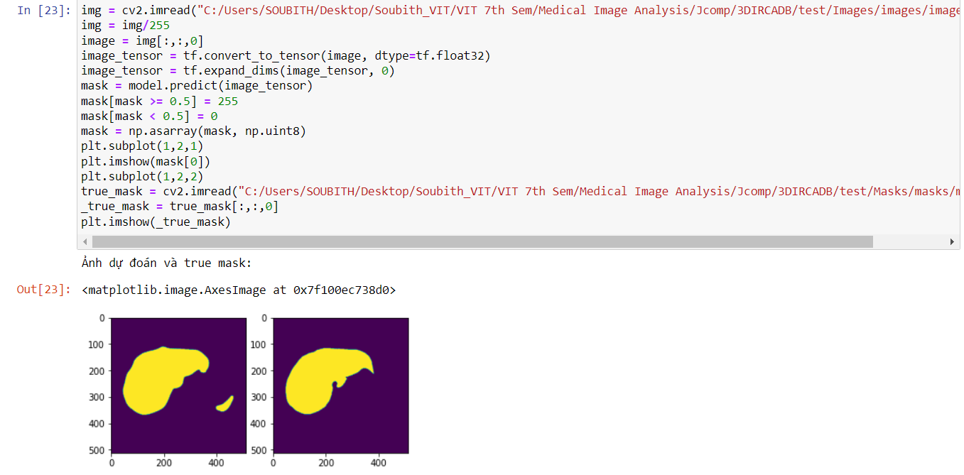
Implementation

Slide 19
Conclusion
Liver segmentation is a crucial step in medical image analysis, playing a pivotal role in liver cancer diagnosis, treatment planning, and monitoring. UNet, a convolutional neural network (CNN) architecture, has emerged as a powerful tool for liver segmentation, demonstrating remarkable performance in various medical imaging applications.
As deep learning techniques continue to evolve, their role in liver tumor segmentation is expected to grow even more prominent. Data Augmentation; Utilizing data augmentation techniques can expand the dataset and enhance the network's generalization ability, leading to more robust segmentation performance. Transfer Learning; Leveraging transfer learning from pre-trained models can accelerate the training process and improve the network's segmentation capabilities. Multi-Task Learning; Incorporating additional tasks, such as lesion segmentation or tissue classification, can further enhance the network's overall performance.

Slide 20
THANK YOU!

